Slide 1
Dual H-bridge Motor Controller
Hussam Al-Hertani

Slide 2
Motivation
Design a dual motor controller circuit capable of handling up to 7A of current per motor
Motor controller can control speed and direction of both motors
Can drive a single bipolar stepper motor
Can be used in many robotics applications

Slide 3
Outline
Introduction to motor control
H-bridge motor controller design
Block diagram
Circuit design
Layout design
Specifications
Milestones
Future modifications

Slide 4
Introduction
Utilize discrete components to design a cost effective 7A dual motor controller
Many discrete solutions exist such as :
SN754410 dual 1A motor controller with direction and speed control
L298 dual 4A motor controller with direction and speed control
These devices typically have smaller maximum current drives.
They’re not as fun to build!

Slide 5
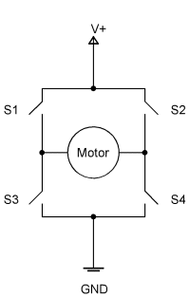
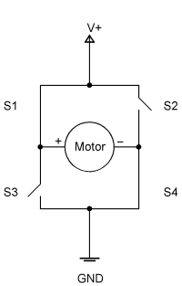
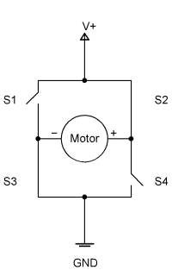
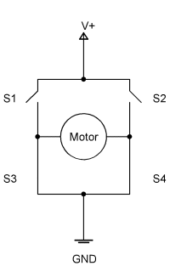
H-bridge Direction Control
(a) Coast (b) Direction A (b) Direction B (c) Brake
The H-bridge model allows us to reverse current direction across the motor
We can also put the motor in brake and coast modes!

Slide 6
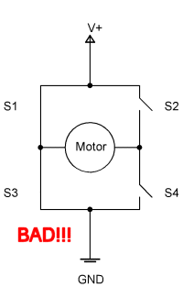
H-bridge Direction Control
Beware of turning on S2 and S4 or S1 and S3 at the same time!!!!
Can short circuit the power supply causing major damage to the switches and power supply.

Slide 7
Choosing Transistors
We will need to choose an electrically controlled switch in place of S1-S4.
We can use general purpose bipolar junction transistors such as 2N2222 (NPN)/2N2907(PNP)
These have maximum current driving ability of 600mA and ought to be used only with very small motors
We can use power BJTs such as TIP122 & TIP 127.
These have maximum current driving ability of 5A.
Not very power efficient
We can use power FETs such as IRF9540 and IRF540
Theoretical maximum current of 23A !
Very power efficient
We used the Power FETs (HexFETs)

Slide 8
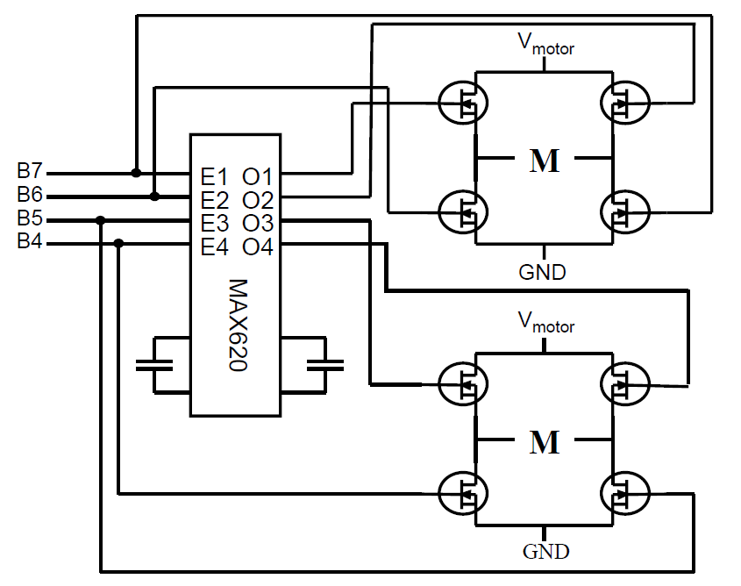
Choosing Transistors
When designing an H-bridge configuration we can choose to replace all 4 switches with NFETS
All FETS are matched for maximum power efficiency.
Gate voltage of the top FETS must be larger than motor voltage by approximately 10 volts most use a high-side driver chip (charge pump) to do this e.g. MAX620/621 chip
This is crucial for high-current (100A+) motor driver circuits

Slide 9
Choosing Transistors
Alternatively we can use 2 PFETs on the high side and two NFETs for the low side
Transistors are not perfectly matched and thus power efficiency is not optimal
Easier to design, less parts. Adequate for up to 30A of current drive
We used this configuration

Slide 10
Choosing FET Drivers
Logic circuit (e.g. Microcontroller) capable of generating 3.3v/5v.
The IRF9540/IRF540 FETs require a V_{GS} of at least 10 volts to adequately open the drain-source channel.
Typically we can set the V_{GS} voltage to be the same as the motor voltage.
We can use BJTs to help us level shift 3.3 or 5v logic to the motor voltage.
A better solution is to use a MOSFET Driver chip such as the 4427 chip. This provides faster rise/fall times which makes PWM easier to implement
The 4427 chip is able to charge and discharge gate capacitance quickly and efficiently
We used the 4427 chip

Slide 11
Block Diagram
Micro-controller
Logic
Circuit
4427
MOSFET
Driver
MOSFET
H-Bridge Circuit
4427
MOSFET
Driver

Slide 12
Logic Circuit
Placed between the microcontroller and the 4427 MOSFET drivers.
Used to facilitate speed control via pulse width modulation
Used to ensure that the power supply is never short circuited
Requires the use of only 2 AND gates per H-bridge.
A single quad 2-input AND chip (7408) can be used for both H-bridges

Slide 13
FlyBack Diodes
Diodes added to smooth out the inductive spikes created whenever the motors are turned ON or OFF.
HEXFETS already have body diodes that perform this function
We decided to add additional 1A fast response Schottky diodes (1N5817) just to be safe.

Slide 14
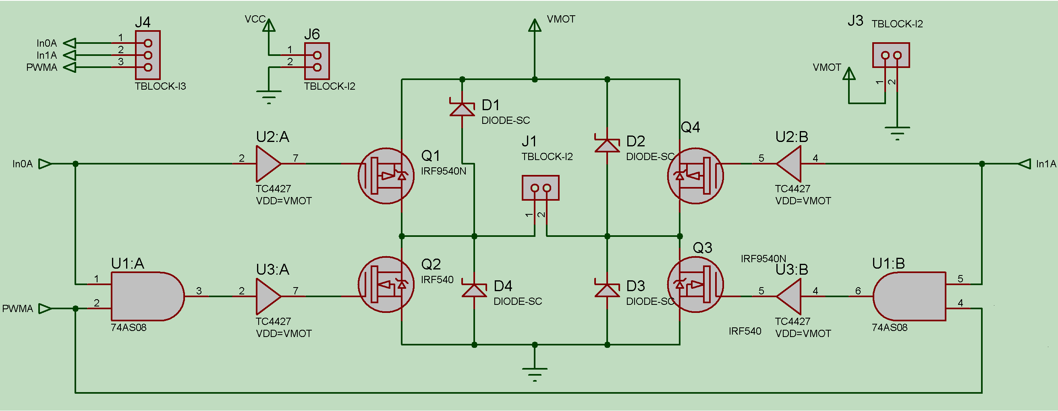
Schematic – 1 H-bridge

Slide 15
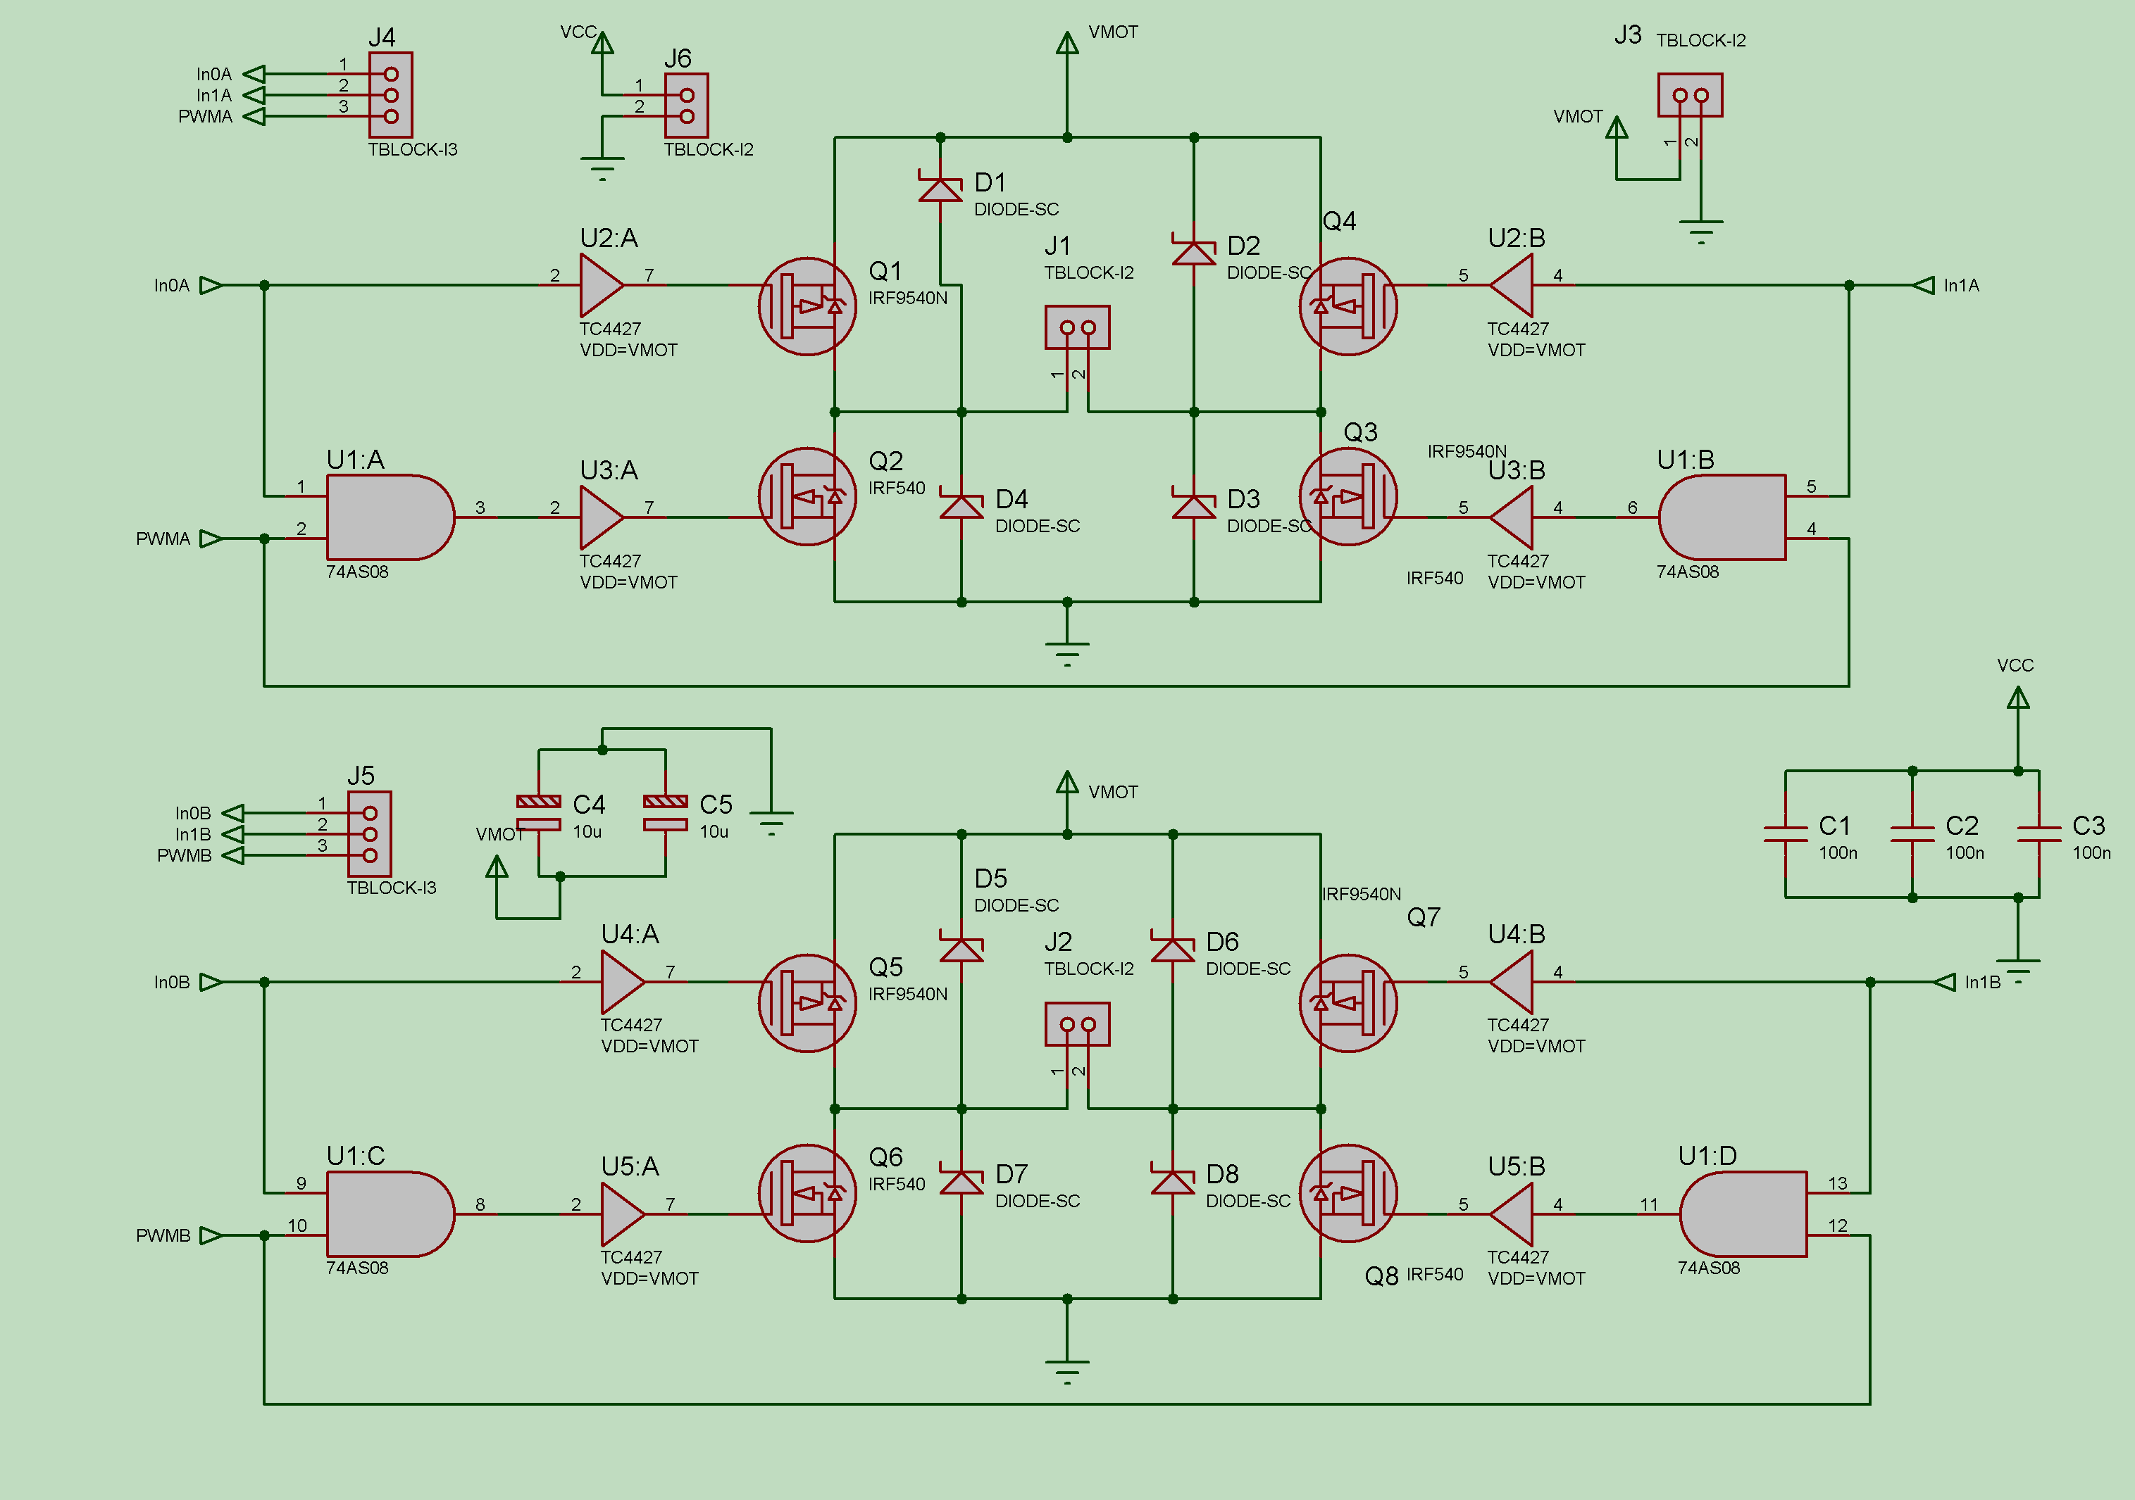
Schematic – Both H-bridges

Slide 16
Layout Considerations
When laying out the high current traces, 40 Mil traces were used on both the bottom and top layers of the PCBs. Vias were used to connect them.
This had the effect of providing an effective 80mil trace widths (approximately 7A of current)
Power planes were used on a two layer board
Ground plane was placed on the bottom layer
Logic +5V/+3.3v and motor voltage power planes where both placed on the top copper layer
Power planes make the routing the board easier as well as provides large sources and sinks for the motor current.

Slide 17
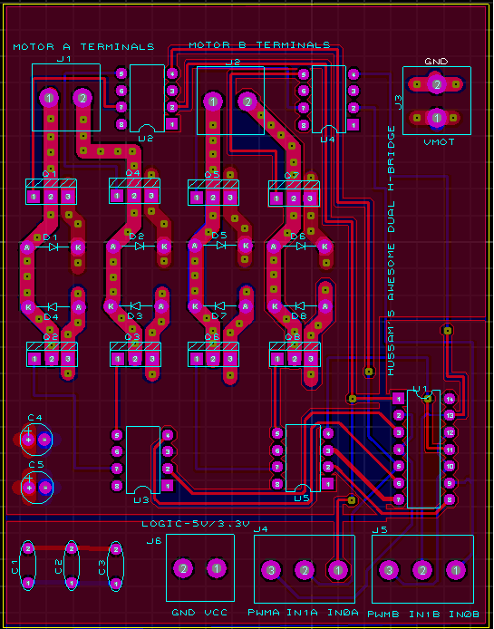
Layout- Top Copper Layer

Slide 18
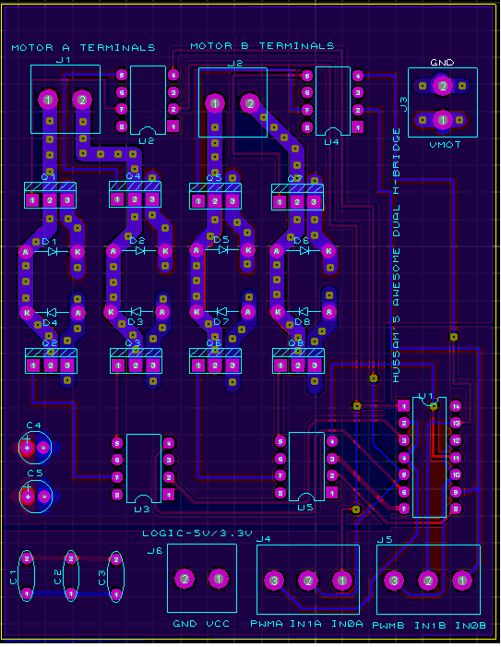
Layout- Bottom Copper Layer

Slide 19
Specifications
Maximum Motor Current: 8A…limited by trace widths (can probably handle more though)
Maximum Motor Voltage: 18V (limited by 4427 driver….FETS can handle much more)
Maximum Logic Voltage: 5V
Maximum PWM Frequency: 100KHz (recommend to use 30-50KHz….depends on motor also)
Temperature Extremes: -15C to 80C

Slide 20
Milestones
Activity | Week #
Brainstorming | Week 1
Complete Breadboard Testing | Week 3
Design Layout and send it out for fabrication | Week 5
Order Parts | Week 6
Receive PCB , populate PCB & Test PCB | Week 10
Extensive Testing | Week 13

Slide 21
Errors
Silk screen labels on the motor voltage power terminal were reversed!!!!!
Not good!
Lesson Learnt: Label all terminals with care

Slide 22
Proposed Improvements
Increase trace widths to accommodate even more current.
Integrate a microcontroller with USB (ATMega32U4) on board
Integrate female headers for placement of sensors.
This way the circuit can be used as the brains of a wheeled mobile robot!!
Consider using the IRLU024N/ IRFU5505 HEXFETs.
Rated for less current (around 17A), but are cheaper and smaller

Slide 23

Questions!

